Slide 1

Department of ECE
ANALOG ELECTRONIC CIRCUIT DESIGN 22EC2104A
CO-2
Session-3 JFET Biasing

Slide 2





AIM OF THE SESSION
To familiarize students with the biasing of Junction Field effect Transistor
INSTRUCTIONAL OBJECTIVES
This Session is designed to:
Give introduction biasing
To analysis various biasing circuits
LEARNING OUTCOMES
At the end of this session, you should be able to:
Describe biasing of FET
Analyze the various biasing circuits of FET.

Slide 3
INTRODUCTION
Biasing in junction field-effect transistors (JFETs) is the process of applying proper DC voltages to the gate and source terminals to establish the desired operating point.
The goal of biasing is to ensure that the JFET operates in its linear or active region, where it exhibits the desired characteristics.
By selecting appropriate bias voltages, the JFET can maintain a stable and predictable operating point, enabling reliable signal amplification or switching.
Biasing involves setting the gate-to-source voltage (VGS) at a level that establishes the desired drain current (ID) and ensures that the JFET operates within its specified parameters, such as avoiding cutoff or saturation regions.

Slide 4
FET BIASING
The analysis or design of a transistor amplifier needs a knowledge of both the dc and the ac response of the system.
It is assumed that the transistor is a magical device
that can raise the level of the applied ac input without the assistance of an external energy source.
In reality, any increase in ac voltage, current, or power is the result of a transfer of energy from the applied dc supplies.
The biasing levels for a silicon transistor configuration can be obtained using the approximate characteristic equations V_{BE}=0.7V, I_{C}=βI_{B}, and I_{C} is approximately equals to I_{E.}

Slide 5
Cont…
The fact that beta is a constant establishes a linear relationship between I_{C} and I_{B}.
The general relationships that can be applied to the dc analysis of all FET amplifiers are I_{G} is approximately equals to 0A and I_{D}=I_{S}
For JFETs and depletion-type MOSFETs and MESFETs, Shockley’s equation is applied to relate the input and output quantities.
For enhancement-type MOSFETs and MESFETs, I_{D} = k(V_{GS} - V_{T})² equation is applicable.
where k = Process transconductance parameter

Slide 6
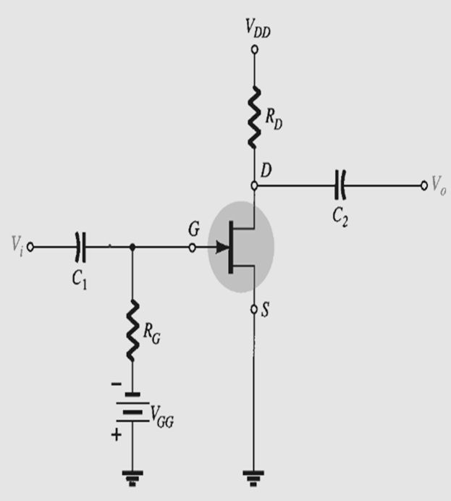
FIXED BIAS CONFIGURATION
Fixed bias is one of the few FET configurations that can be solved just as directly using either a mathematical or a graphical approach.
The fixed bias configuration includes the ac levels Vi and Vo and the coupling capacitors (C₁ and C₂).
Recall that the coupling capacitors are “open circuits” for the dc analysis and low impedances for the ac analysis.
The resistor R_{G} is present to ensure that Vi appears at the input to the FET amplifier for the ac analysis.
For the dc analysis,
I_{G}=0A
and V_{RG} = I_{G} R_{G} = (0)R_{G} = 0 V

Slide 7
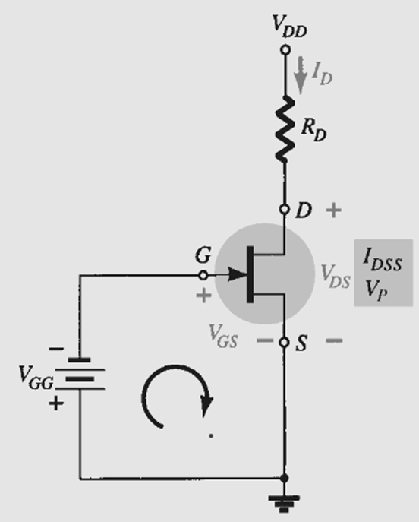
Cont…
Applying Kirchhoff’s voltage law in the clockwise direction of the indicated loop
-V_{GG} - V_{GS} = 0
V_{GS} = -V_{GG}
Since V_{GG} is a fixed dc supply, the voltage V_{GS} is fixed in magnitude, resulting in the designation “fixed-bias configuration”.
The resulting level of drain current I_{D} is now controlled by Shockley’s equation
I_{D}=I_{DSS} (1-V_{GS} /V_{P})²

Slide 8
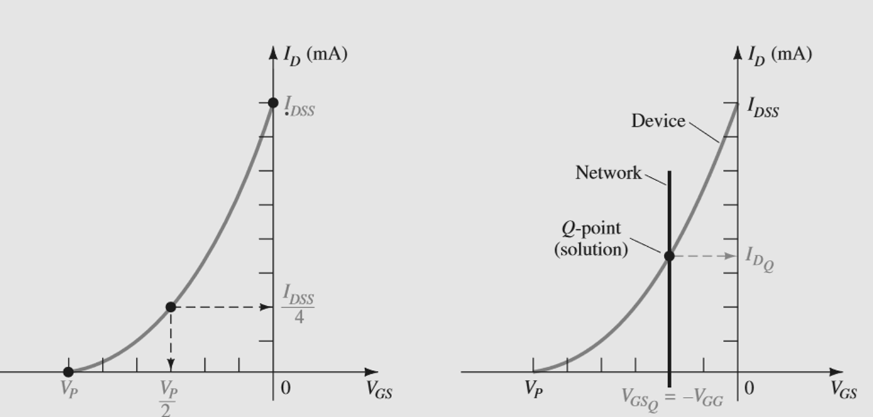
GRAPHICAL ANALYSIS

Slide 9
OPERATION
The drain-to-source voltage of the output section can be determined by applying Kirchhoff’s voltage law as follows:
+V_{DS} + I_{D}R_{D} - V_{DD} = 0
V_{DS} = V_{DD} - I_{D} R_{D}
V_{S} = 0 V
V_{DS} = V_{D} - V_{S}
or V_{D} = V_{DS} + V_{S} = V_{DS} + 0 V
V_{D} = V_{DS}
V_{GS} = V_{G} - V_{S}
or V_{G} = V_{GS} + V_{S} = V_{GS} + 0 V
V_{G} = V_{GS}

Slide 10
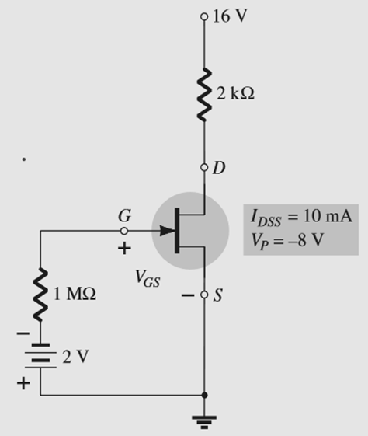
PROBLEM
Determine a. V_{GSQ}., b. I_{DQ}. c. V_{DS} , d. V_{D}., e. V_{G} , f. V_{S}. For the following network.
Mathematical Approach
a. V_{GSQ} = -V_{GG} = -2 V
b. I_{DQ}=I_{DSS} (1-V_{GS} /V_{P})² = 5.625mA
c. V_{DS} = V_{DD} - I_{D} R_{D} = 4.75 V
d. V_{D} = V_{DS} = 4.75 V
e. V_{G} = V_{GS} = -2 V
f. V_{S} = 0 V

Slide 11
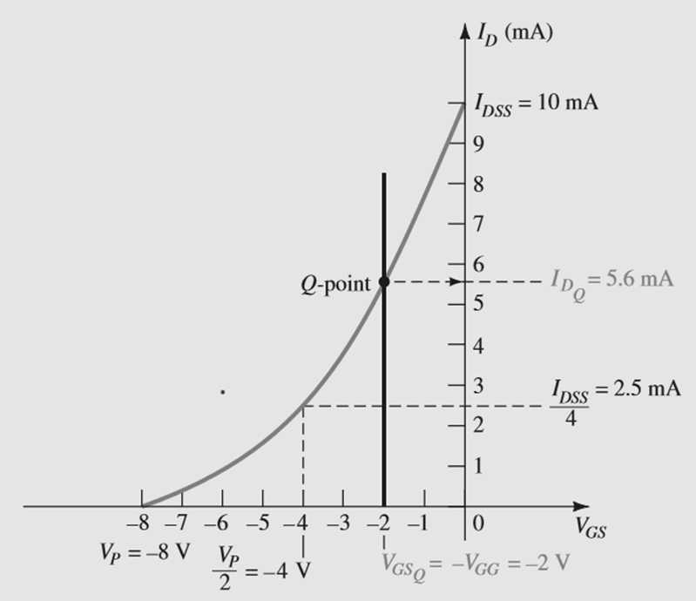
Cont…
Graphical approach
A.V_{GSQ}=-V_{GG}=2V
b.I_{DQ}=5.6mA
c.V_{DS}=V_{DD}-I_{D}R_{D}=4.8V
d. V_{D}=V_{DS}=4.8V
e. V_{G} = V_{GS} = 2 V
f. V_{S} = 0 V

Slide 12
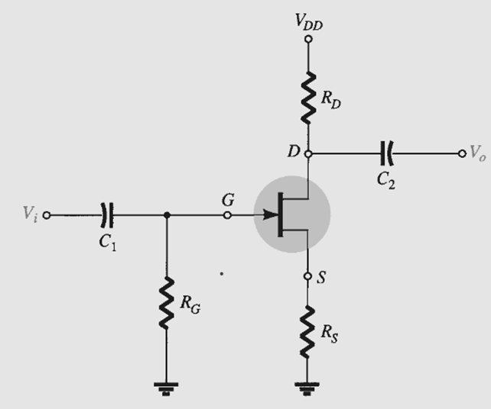
SELF BIAS CONFIGURATION
The self-bias configuration eliminates the need for two dc supplies.
The controlling gate-to-source voltage is now determined by the voltage across a resistor R_{S} introduced in the source leg of the configuration.
For the dc analysis, the capacitors can again be replaced by “open circuits” and the resis
tor R_{G} replaced by a short-circuit equivalent since I_{G} = 0A. The result is the network of
Fig for the important dc analysis.

Slide 13
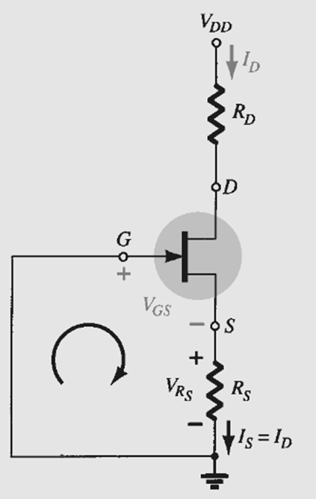
Cont…
The current through RS is the source current IS, but IS = ID and
V_{RS} = I_{D} R_{S}
For the indicated closed loop of Fig., we find that
-V_{GS} - V_{RS} = 0 and V_{GS} = -V_{RS}
or V_{GS} = -I_{D}R_{S}
A mathematical solution could be obtained as follows
I_{D}=I_{DSS} (1+I_{D}R_{S}/V_{P})²
Rearranging terms, we obtain an equation of the form:
I²_{D} + K₁I_{D} + K₂ = 0

Slide 14
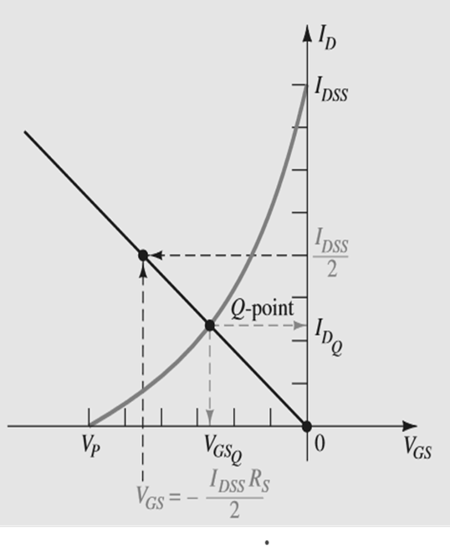
Cont…
Graphical approach
The graphical approach requires defines a straight line on the same graph and simply draw a straight line between the two points.
The most obvious condition to apply is I_{D} = 0 A since it results in V_{GS}= -I_{D}R_{S} = (0 A)R_{S} =0 V
The second point we choose a level of ID equal to one-half the saturation level.
That is, I_{D}=I_{DSS}/2
Then V_{GS}=-I_{D}R_{S}=-I_{DSS}R_{S}/2

Slide 15
Cont…
The level of V_{DS} can be determined by applying Kirchhoff’s voltage law
to the output circuit, with the result that
V_{RS} + V_{DS} + V_{RD} - V_{DD} = 0
and V_{DS} = V_{DD} - V_{RS} - V_{RD} = V_{DD} - I_{S} R_{S} - I_{D} R_{D}
I_{D} = I_{S}
V_{DS} = V_{DD} - I_{D}(R_{S} + R_{D})
V_{S} = I_{D} R_{S}
V_{G} = 0 V
V_{D} = V_{DS} + V_{S} = V_{DD} - V_{RD}

Slide 16
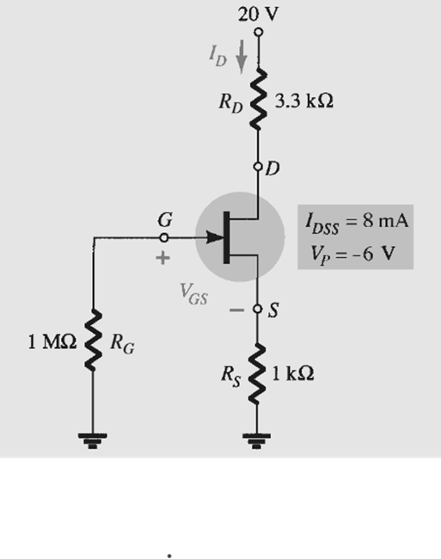
PROBLEM
Determine a. V_{GSQ}., b. I_{DQ}. c. V_{DS} , d. V_{D}., e. V_{G} , f. V_{S}. For the following network.
The gate-to-source voltage is determined by
V_{GS} = -I_{D}R_{S}
Choosing I_{D} = 4 mA, we obtain
V_{GS} = -(4 mA)(1 kΩ) = -4 V

Slide 17
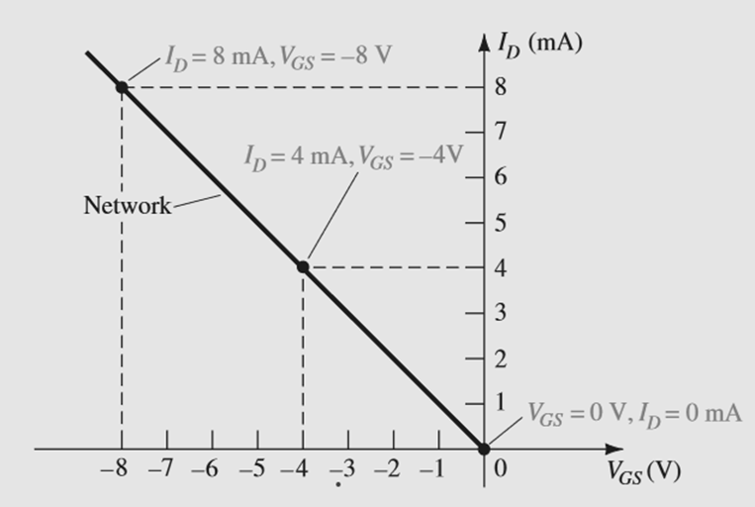
Cont…
If we happen to choose I_{D} = 8 mA, the resulting value of V_{GS} would be -8 V, as
shown on the same graph.
In either case, the same straight line will result, clearly demonstrating that any appropriate value of I_{D} can be chosen as long as the corresponding value of V_{GS}
In addition, keep in mind that the value of V_{GS} could be chosen and the value of I_{D} determined graphically.

Slide 18
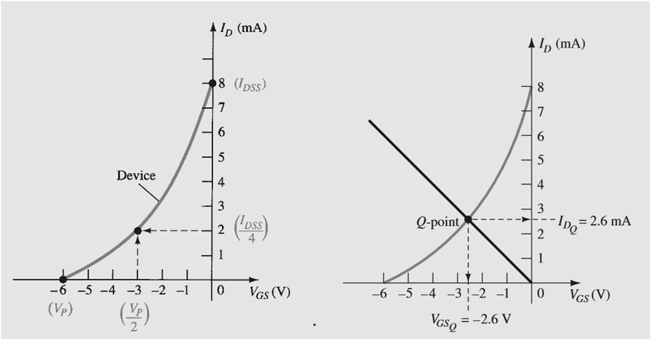
Cont…

Slide 19
Cont…
a. V_{GSQ} = 2.6 V
b. At the quiescent point
I_{DQ} = 2.6 mA
c. V_{DS} = V_{DD} - I_{D} (R_{S} + R_{D}) = 20 V - (2.6 mA)(1 kΩ+ 3.3 kΩ) = 20 V - 11.18 V = 8.82 V
d. V_{S} = I_{D}R_{S}= (2.6 mA)(1 kΩ)= 2.6 V
e. V_{G} = 0 V
f. V_{D} = V_{DS} + V_{S} = 8.82 V + 2.6 V = 11.42 V
or V_{D} = V_{DD} - I_{D} R_{D} = 20 V -(2.6 mA)(3.3 kΩ) = 11.42 V

Slide 20
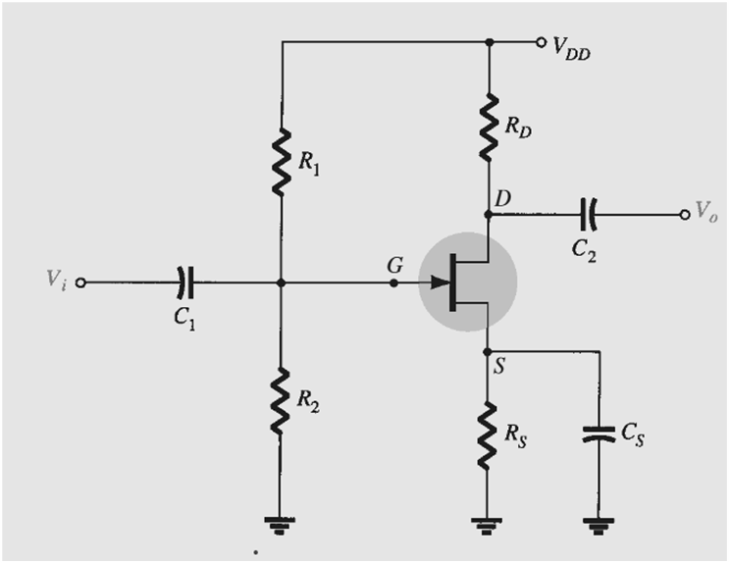
VOLTAGE DIVIDER BIAS
The voltage-divider bias arrangement applied to BJT transistor amplifiers is also applied to FET amplifiers.
The basic construction is exactly the same, but the dc analysis of each is quite different.
I_{G} = 0 A for FET amplifiers, but the magnitude of I_{B} for common-emitter BJT amplifiers can affect the dc levels of current and voltage in both the input and output circuits.
Recall that I_{B} provides the link between input and output circuits for the BJT voltage-divider configuration, whereas V_{GS} does the same for the FET configuration.

Slide 21
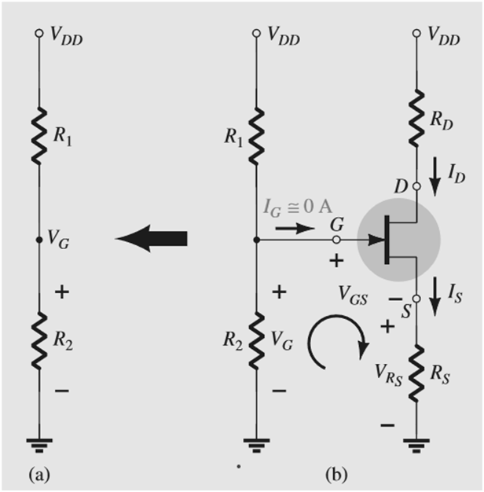
ENHANCEMENT-TYPE MOSFET P-CHANNEL
V_{G}=R2.V_{DD}/(R1 + R2)
Applying Kirchhoff’s voltage law in the clockwise direction to the indicated loop of Fig. results in
V_{G}-V_{GS}-V_{RS}=0
and V_{GS} = V_{G} – V_{RS}
Substituting V_{RS} = I_{S} R_{S} = I_{D} R_{S}, we have
V_{GS} = V_{G} - I_{D} R_{S}

Slide 22
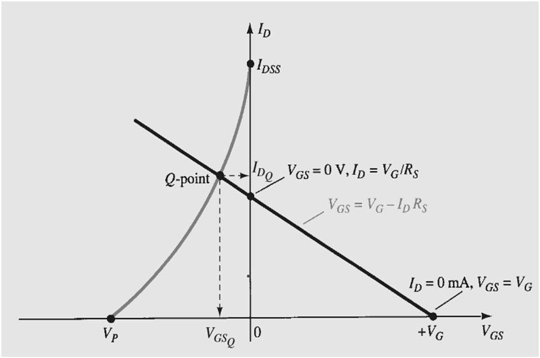
Cont…
If we select I_{D} to be 0 mA, we are in essence stating that we are somewhere on the horizontal axis. The exact location can be determined simply by substituting I_{D} = 0mA into Eq. and finding the resulting value of V _{GS}
V_{GS}=V_{G}-I_{D}R_{S}=V_{G}-(0mA)R_{S}
and V_{GS} = V_{G} at I_{D} = 0 mA
V_{GS} = V_{G} - I_{D}R_{S}
0 V = V_{G} - I_{D}R_{S}
I_{D} = V_{G}/R_{S} at V_{GS} = 0 V

Slide 23
Cont…
Once the quiescent values of I_{DQ} and V_{GSQ} are determined, the remaining network analysis can be performed in the usual manner. That is,
V_{DS} = V_{DD} - I_{D}(R_{D} + R_{S})
V_{D} = V_{DD} - I_{D} R_{D}
V_{S} = I_{D} R_{S}
IR1 = IR2 = V_{DD}/(R1 + R2)

Slide 24
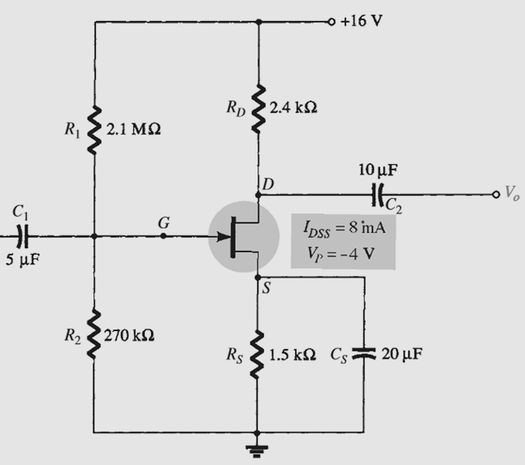
PROBLEM
Determine a. V_{GSQ}., b. I_{DQ}. c. V_{DS} , d. V_{D}., e. V_{G} , f. V_{S}. For the following network.
For the transfer characteristics, if I_{D} = I_{DSS} /4 = 8 ma/4 = 2 mA, then V_{GS} =V_{P/}2 = -4 V/2 = -2 V. The resulting curve representing Shockley’s equation appears in Fig. The network equation is defined by
V_{G} = R2V_{DD}/(R1 + R2)= 1.82 V
and V_{GS} = V_{G} - I_{D}R_{S}
= 1.82 V - I_{D}(1.5 kΩ)

Slide 25
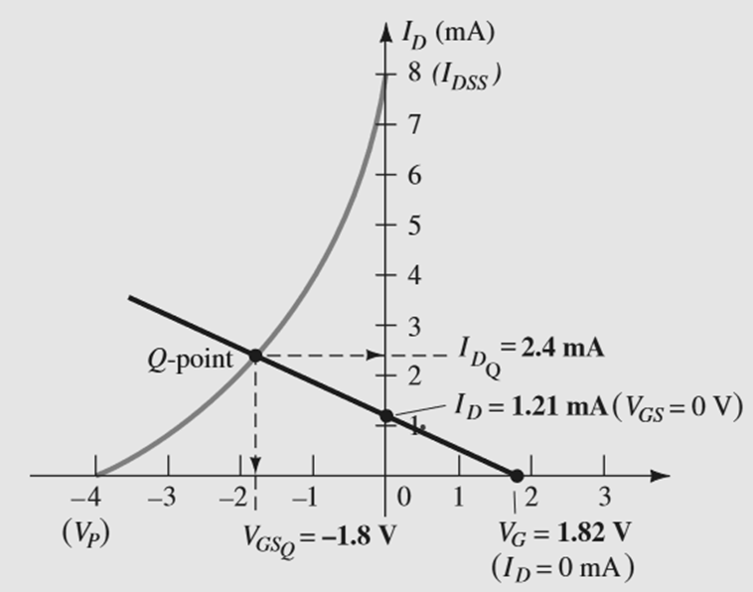
Cont…
When I_{D} = 0 mA, V_{GS} = +1.82 V
When V_{GS} = 0 V, I_{D} = 1.82 V/1.5 kΩ = 1.21 mA
I_{DQ} = 2.4 mA
and V_{GS Q} = 1.8 V

Slide 26

SUMMARY
Biasing in field-effect transistors (FETs) involves establishing proper DC voltages to ensure the desired operating conditions.
By selecting appropriate bias voltages, the FET can operate in its linear region, providing reliable amplification or switching. Biasing primarily focuses on setting the gate-to-source voltage (VGS) to establish the desired drain current (ID) and ensure the FET operates within specified parameters.
It aims to avoid cutoff or saturation regions and maintain a stable operating point.
Proper FET biasing is crucial for achieving optimal performance, stability, and linearity in various electronic applications, such as amplifiers, oscillators, and digital circuits.

Slide 27
SELF-ASSESSMENT QUESTIONS
1.Biasing in JFET refers to:
a) Applying an external voltage to the gate terminal
b) Establishing the DC operating conditions for proper device operation
c) Controlling the drain current using the gate voltage
d) None of the above
2.The purpose of JFET biasing is to:
a) Prevent current flow through the channel
b) Ensure the JFET operates in the saturation region
c) Stabilize the Q-point for proper amplification
d) Control the gate voltage for maximum output power

Slide 28
TERMINAL QUESTIONS
What is biasing?
For high gain which type of bias is proffered?
What is Q point?

Slide 29
REFERENCES FOR FURTHER LEARNING OF THE SESSION
Reference Books:
1. Jacob Millman - “Electronic Devices and Circuits”, 4th Edition, McGraw Hill Education (2015)
2. D Roy Choudhury and Shail B. Jain – “Linear Integrated Circuits”, 4th Edition, New Age International Pvt.Ltd. (2017)
3. David A. Bell - “Electronic Devices and Circuits”, 5th Edition, Oxford University Press (2008)
Sites and Web links:
https://www.learnelectronicswithme.com/2020/07/what-is-jfet-construction-and-working.html
https://electronicspost.com/explain-the-construction-and-working-of-a-jfet-what-is-the-difference-between-a-jfet-and-a-bjt/
https://electronicsdesk.com/junction-field-effect-transistor.html

Slide 30
THANK YOU
Team – ANALOG ELECTRONIC DEVICES AND CIRCUITS

